Slide 1








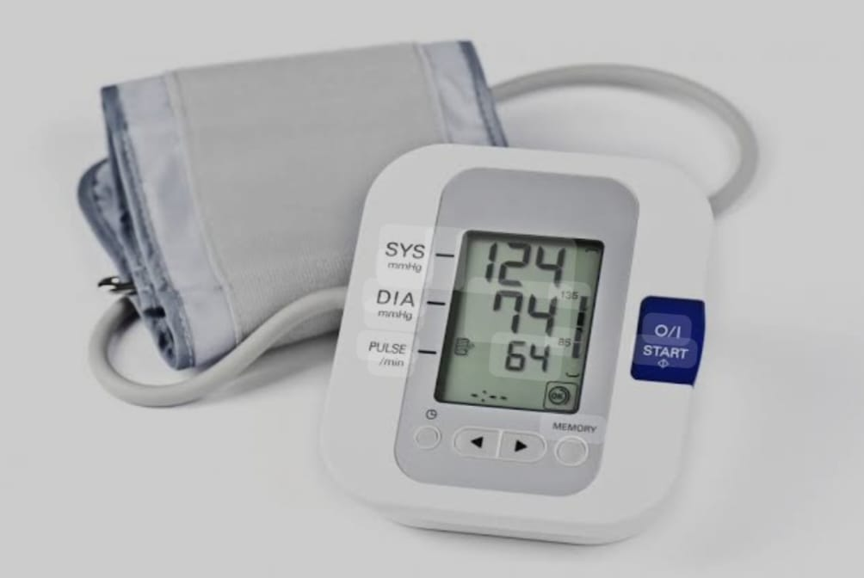
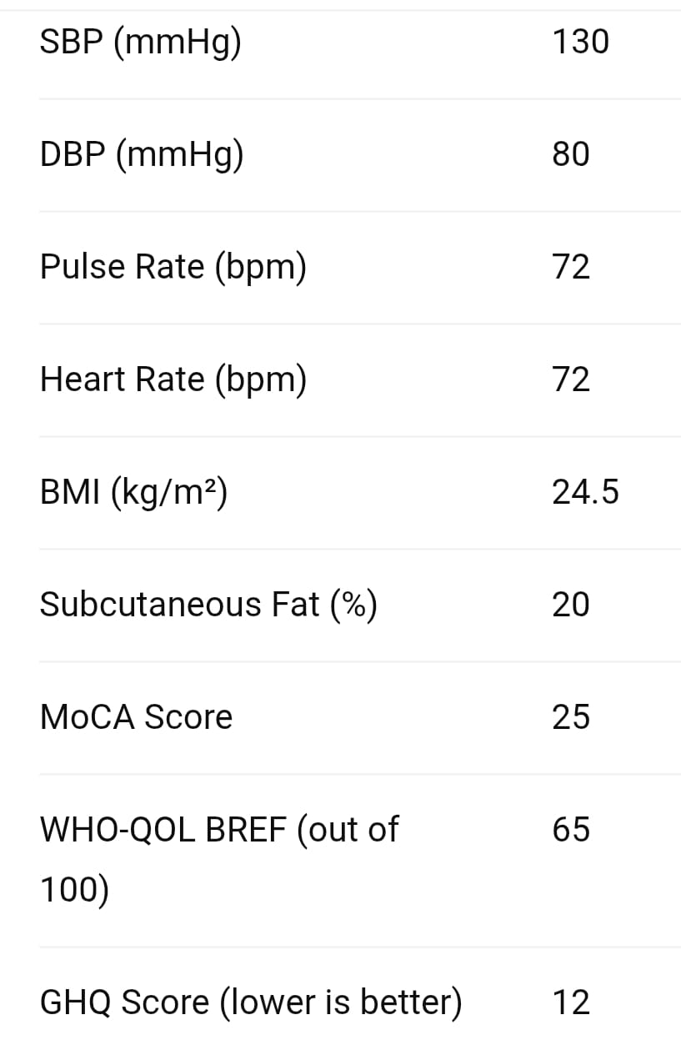
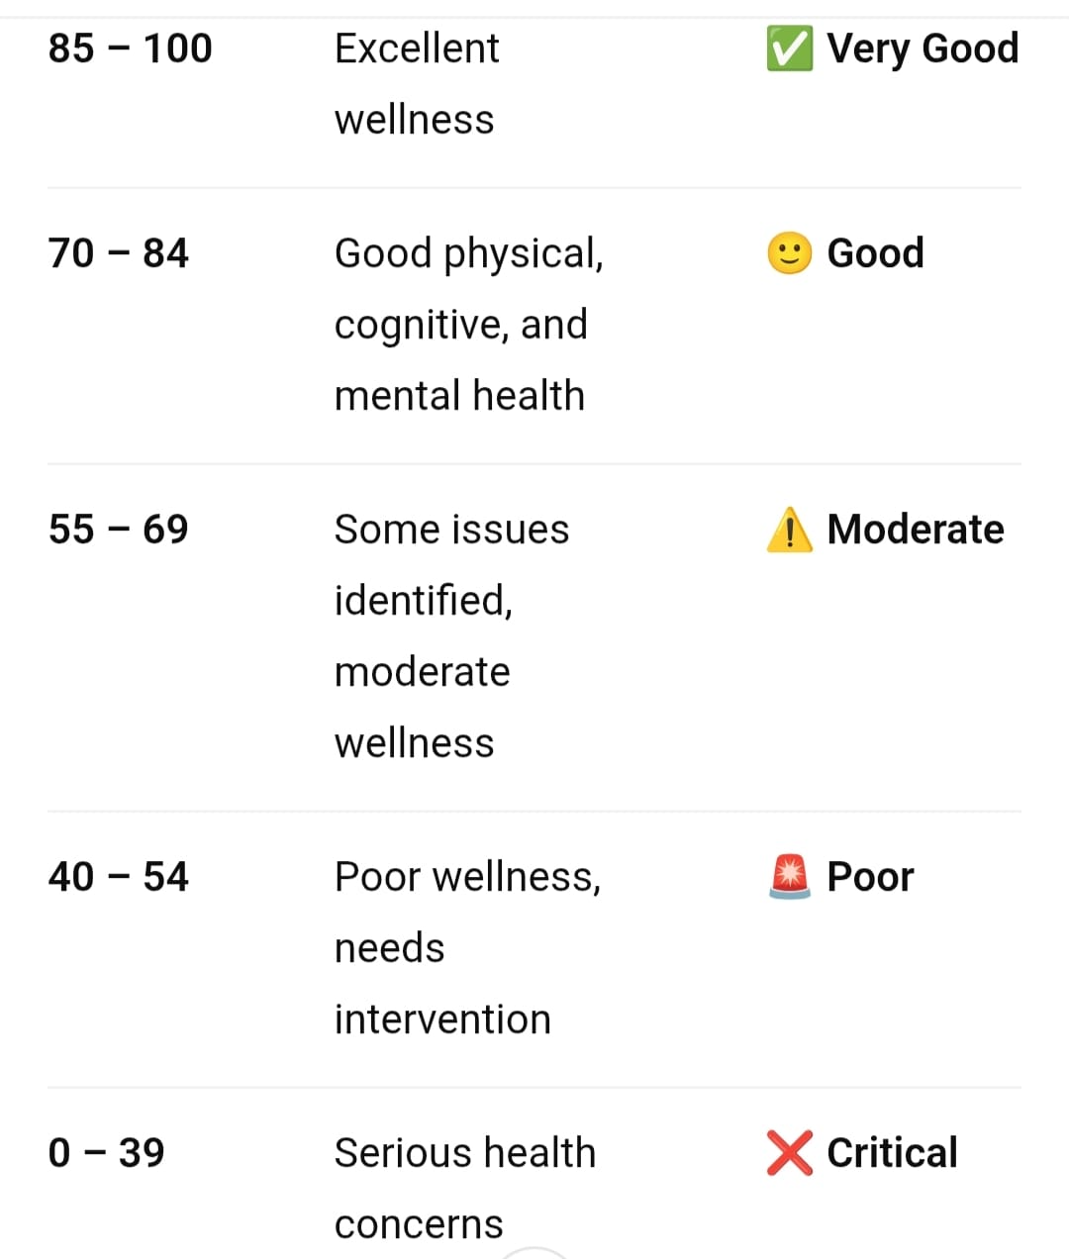


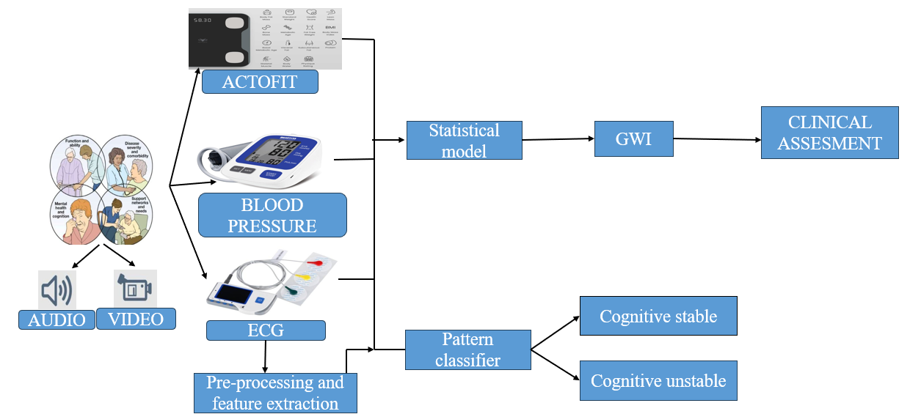
 | DAYANANDA SAGAR COLLEGE OF ENGINEERING ​(An Autonomous Institute affiliated to Visvesvaraya Technological University (VTU), Belagavi, Approved by AICTE and UGC, Accredited by NAAC with 'A' grade & ISO 9001-2015 Certified Institution) Shavige Malleshwara Hills, Kumaraswamy Layout, Bengaluru - 560 111.
DEPARTMENT OF MEDICAL ELECTRONICS ENGINEERING
(Accredited by NBA Tier 1: 2023-2026)
MINI PROJECT 1 (22MD49) (SDG 3,9)
ELDERLY CARE: “Development Of Geriatric Wellness Index”
MP3004/24-34
GROUP NO.: 13
GROUP MEMBERS & USN:
Tvisha Ranganath (1DS23MD056)
TGM Sumanth (1DS23MD052)
Manushree V (1DS23MD017)
4. Shreya M (1DS23MD042)
SUPERVISOR-
Dr. N Sriraam
(HOD, MD, DSCE)
CO-SUPERVISOR-
Dr. Geetha N K
(Professor, Mathematics, DSCE)
RESULT
AIM & OBJECTIVES
To assess physical, mental, emotional and social health in the elderly.
Evaluate their ability to perform ADLs and IADLs using wearable technologies and statistical analysis.
HARDWARE COMPONENTS –
SOFTWARE COMPONENTS -
GWI
30.9/100
PROPOSED METHODOLOGY
CONCLUSION
Geriatric Wellness Index (GWI) integrates wearable data and cognitive assessments to monitor elderly well-being and daily functionality. Advanced statistical models (GLM, survival & regression) enable early risk detection and support data-driven clinical care.
INNOVATIVE COMPONENT OF THE PROJECT Integration of multi-dimensional health data with advanced models (GLM, survival, regression) to develop a unified Geriatric Wellness Index (GWI) for real-time elderly health insights.

